Slide 1


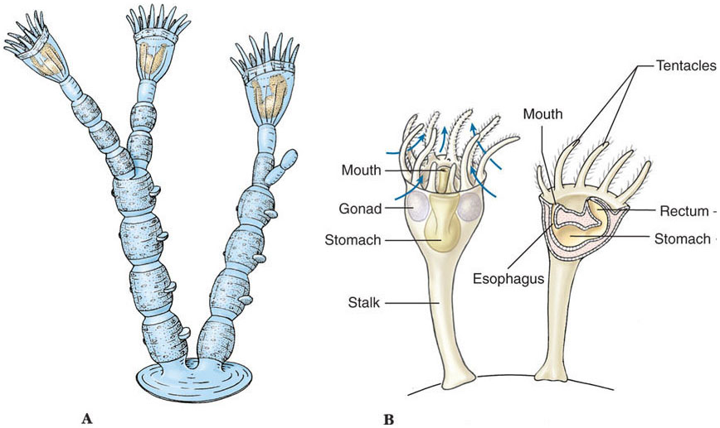
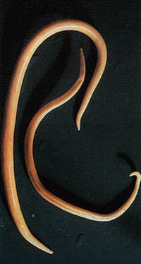
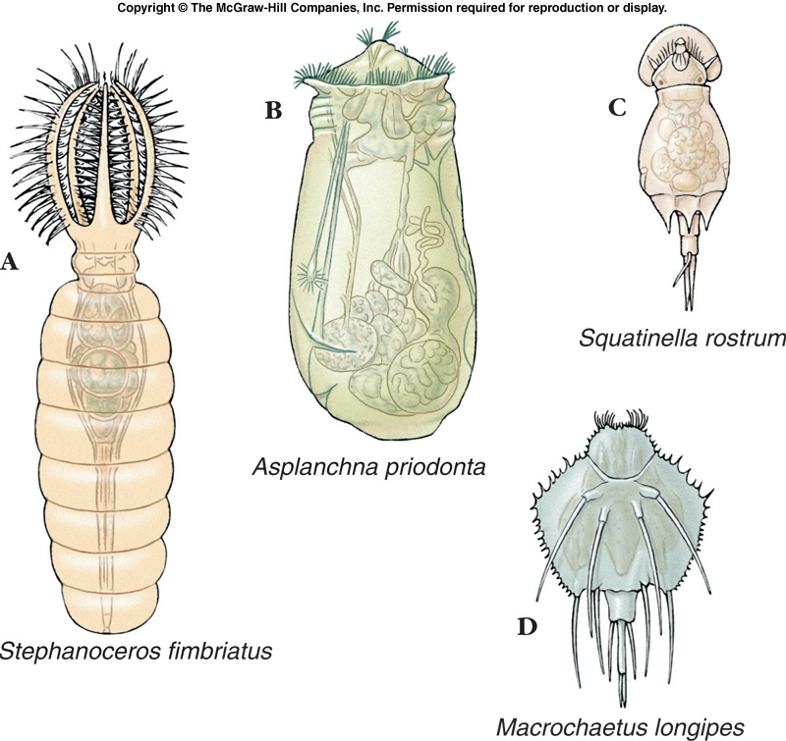
BASRAH UNIVERSITY
Faculty of Education for Pure Sciences
Biology Department
2025- 2026
Phylum :Aschelminthes
Presented By: Prof. Dr. Sabeeh H. AL-Mayah

Slide 2
Seven different Phyla grouped into either the Lophotrochozoan (those that do NOT molt)
or
Ecdysozoan (those that DO molt).
Dioecious (separate sexes) .Pseudocoelomates have a body cavity (the pseudocoel) between the gut (derived from endoderm) and body wall (derived from mesoderm).
Derived from the blastocoel.
Eutelic organisms have a fixed number of somatic cells when reach maturity,
the exact number being constant for any one species.
Development proceeds by cell division until maturity; further growth occurs via cell enlargement only.
Eutely is the condition of having a body made up of a constant number of cells.
Most eutelic organisms are microscopic.
They are bilaterally symmetric.

Slide 3
Advantages of a Body Cavity
A body cavity, pseudocoel or coelom, has several advantages. It provides:
Greater freedom of movement.
Space for development of organ systems.
A simple means for circulation of materials around the body.
Storage place for waste products.
A hydrostatic organ.
Common Features of Pseudocoelomates
All have a body wall of epidermis, a dermis, and muscles surrounding the pseudocoel.
The epidermis of many secretes a nonliving cuticle with bristles & spines.
Almost all have a complete digestive tract.

Slide 4
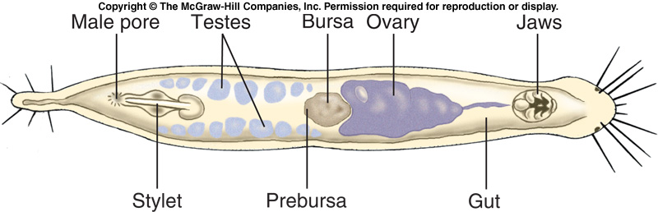
Phylum: Gnathostomulida
Phylum Gnathostomulida includes the jaw worms.
Very small - <2mm.
Live in interstitial spaces of fine coastal sediments.
Can endure low O2.
Feed by scraping bacteria and fungi from the substratum with a pair of jaws on the pharynx.
Sexual stages include males, females, and hermaphrodites.
Fertilization is internal.

Slide 5
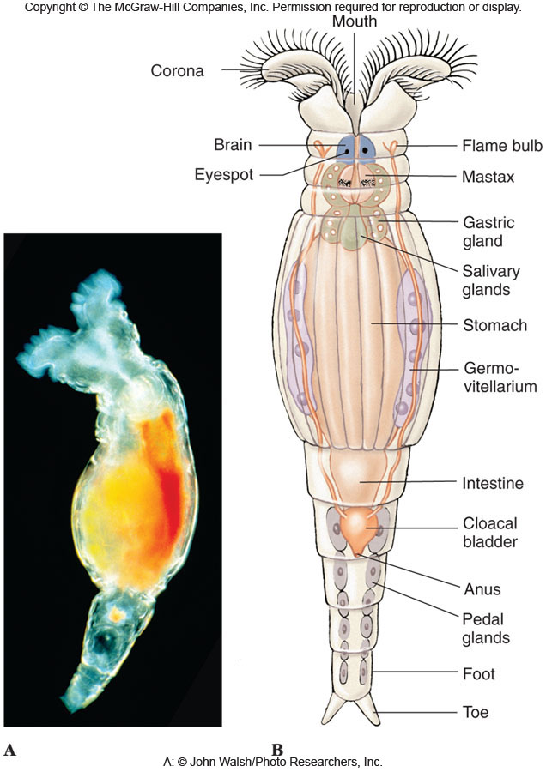
Phylum Rotifera
Members of the phylum Rotifera are pseudocoelomate and have three embryonic germ layers (triploblastic).
Rotifers have a ciliated crown, the corona, that is characteristic of the phylum.
Complete digestive system.
Dioecious (separate sexes) but some species parthenogenetic (females produce diploid eggs).
Some are parthenogenetic during part of the year, depending on environmental conditions.
Thick shelled eggs that can withstand harsh conditions are sometimes produced.

Slide 6
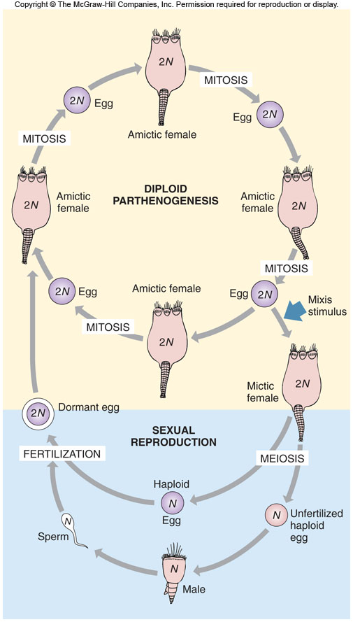
Phylum Rotifera
The female produces two types of eggs. Which are :
1- Summer eggs, which are characterized by their thin shells, and they grow parthenogenetically (without fertilization).They are of two types, the first is small eggs and they produce males, while the other type is large eggs, and they produce female.
2- Winter eggs, which are characterized by their thick shells, and they are fertilized eggs with the ability to resist harsh conditions and only females are produced from these eggs.

Slide 7
Rotifers come in a wide range of colors and shapes.
Shapes often correspond to lifestyle (floaters, swimmers, sessile).
They may be individual or colonial.
Mostly freshwater.
Benthic and pelagic forms.

Slide 8
Phylum: Acanthocephala
All spiny-headed worms (Phylum Acanthocephala) are parasites in the intestines of vertebrates.
Over 1100 species known.
Occur worldwide and parasitize fish, birds, and mammals.
Body somewhat flattened.
About 80% of tegument is a lacunar system of fluid-filled canals that may distribute nutrients and remove wastes from muscles.
No heart - function provided by lacunar fluid.
Both longitudinal and circular body wall muscles are present.
Larvae develop in crustaceans or insects.

Slide 9
Body somewhat flattened.
About 80% of tegument is a lacunar system of fluid-filled canals that may distribute nutrients and remove wastes from muscles.
No heart - function provided by lacunar fluid.
Both longitudinal and circular body wall muscles are present.
No respiratory system.
Protonephridia with flame cells, if present, perform excretory functions.
Nutrients are absorbed across the tegument, which bears some enzymes - no digestive tract.
Dioecious
No species normally parasitizes humans.

Slide 10
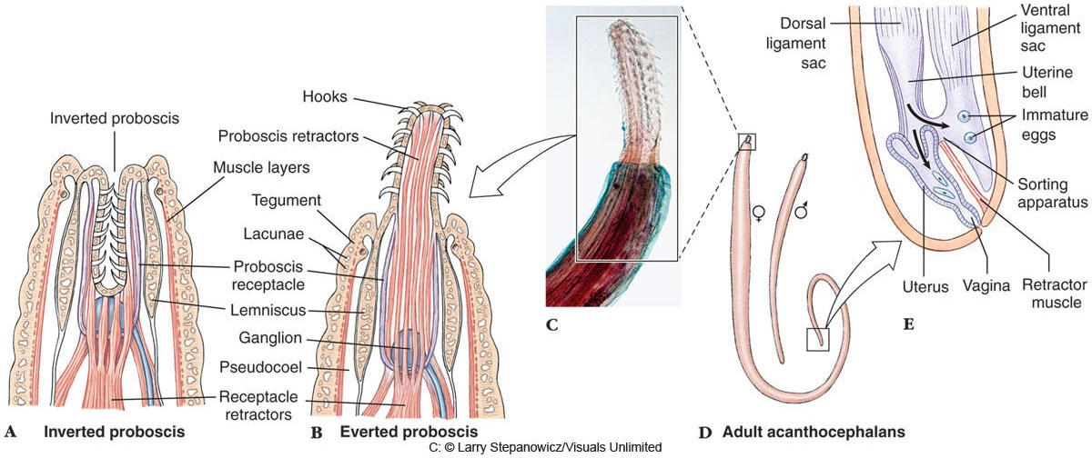
Phylum Acanthocephala
Proboscis has rows of recurved spines that penetrate and may rupture host intestines.
Proboscis with hooks can be inverted into a proboscis receptacle by retractor muscles.

Slide 11
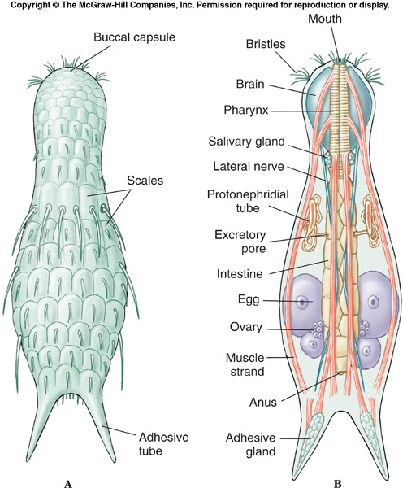
Phylum: Gastrotricha
Gastrotrichs appear similar to rotifers, but without the ciliated corona and have a bristly looking body.
Members of the phylum Gastrotricha are pseudocoelomate and have three embryonic germ layers (triploblastic).
Complete digestive system.
Hermaphroditic or parthenogenetic.

Slide 12
Phylum: Entoprocta
Body or calyx is cup shaped and bears a circular crown of ciliated tentacles.
Attaches by a stalk with adhesive glands.
Tentacles (3-30) and stalk are continuations of the body wall.
Tentacles on lateral and inner surfaces can roll inward but cannot be retracted into the calyx.
Gut is U-shaped with both mouth and anus opening within the circle of tentacles.
Long cilia on sides generate current bringing in particles.
Short cilia on inner surfaces capture food and direct it to mouth.
Pair of protonephridia embedded in gelatinous parenchyma.
Well-developed nerve ganglion on the ventral side of stomach.
No circulatory or respiratory organs.
Some are monoecious, some dioecious, and some first produce sperm and later eggs.
Fertilized eggs develop in a brood pouch.
Modified spiral cleavage leads to trochophore-like larva.
Example : Urnatella gracilis is a common freshwater species in North America.

Slide 13
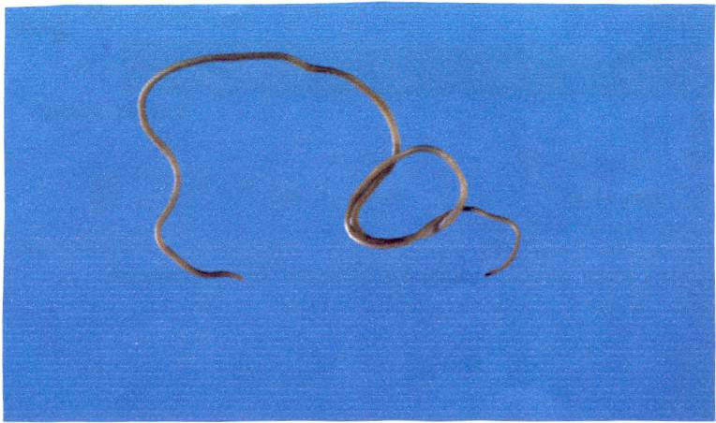
Phylum : Nematomorpha
Likely related to the nematodes.
Known as the “horsehair worms”.
Can grow to be 1 m long but only a few mm wide.
Roughly 325 described species known so far (worldwide).
.

Slide 14
Life Cycle
Female releases long string of eggs into the water (1+ million eggs).
Larvae hatch after 15-80 days.
Enters either an appropriate host or a transport host. Enters the host either by ingestion or penetration.
Begins developing if in the appropriate host. Encysts if in a transport host until it is in an appropriate one (possibly 1+ years if needed).
Enters the digestive tract and feeds off nutrients attained by the host.
4-20 weeks later the juvenile has developed into an adult.
Once the host is in an aquatic environment, the adult nematomorph breaks through the hosts body wall and kills it.
Sexual mating occurs in many species. The male and female become intertwined with their gonopores pressed together.
Doesn’t grow by eutely – grows by increase in cell number.

Slide 15
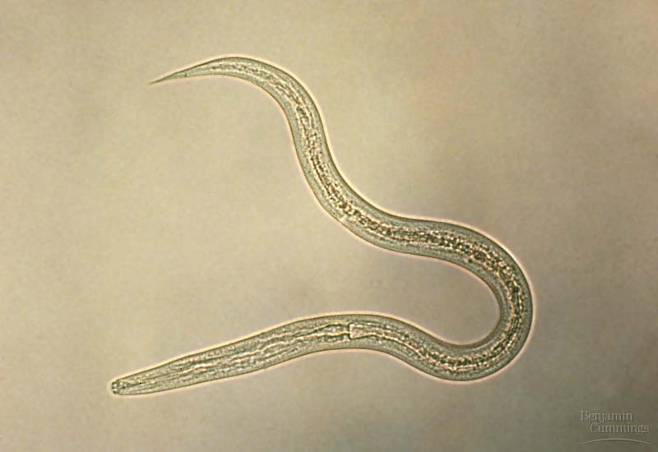
Phylum Nematoda
Ecdysozoan
The roundworms

Slide 16
Phylum Nematoda
Parasites and free-living Marine, freshwater, and soil habitats.
Lack cilia except in their sensory structures
Triploblastic, bilaterally symmetrical.
Unsegmented vermiform (wormlike organism)
Noncellular, collagenous cuticle.
Can molt 4 times during maturation.
Maintains internal hydrostatic pressure
Mechanical protection.
Resists digestion by the host.

Slide 17
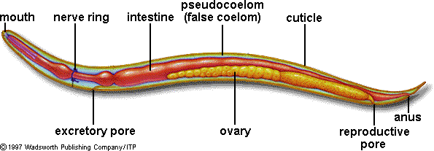
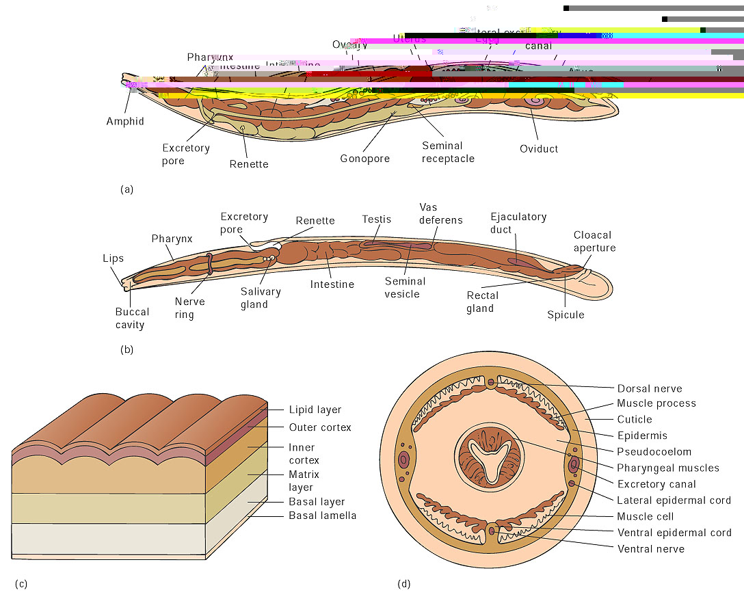

Slide 18
Sensory organs
Amphids – chemoreceptors along the cuticle
Phasmids - chemoreceptors near the anus
Ocelli – eyespots found in aquatic nematodes
Feeding and Digestive System
Carnivores, herbivores, omnivores, saprobes(decomposers), or parasitic .
Complete digestive system.
mouth->buccal cavity->pharynx ->tubular intestine->rectum->anus
Nervous system
Nerve ring from anterior to posterior
Also have neuroendocrine secretions involved in growth, molting, cuticle formation, and metamorphosis.

Slide 19
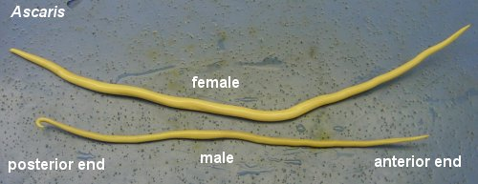
Reproduction
Sexual
Dioecious-having separate sexes
Dimorphic-males are smaller than females
internal fertilization.

Slide 20
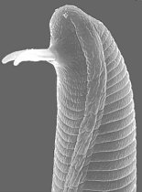
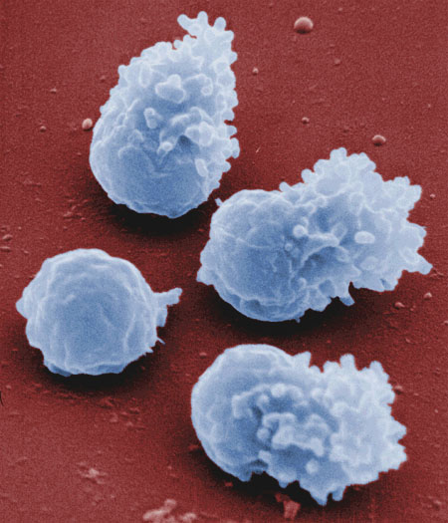
Reproduction
Males
One testis
Bursa- used to insert their sperm
into the female
males have ameboid sperm
Females
Pair of convoluted ovaries
Oviducts become uterus
Several hundred to several hundred- thousand eggs per day.
Ovovivparity – giving birth to
larvae that hatched from an egg

Slide 21
Some Important Nematode Parasites of Humans
Ascaris lumbricoides
Enterobius vermicularis
Ancylostoma duodenale
Trichinella spiralis
Wuchereria bancrofti

Slide 22
Ascaris lumbricoides
The Giant Intestinal Roundworm-
The adult female worm can be over 30 cm long and 2-6 mm wide
800 million infected- most common parasitic worm disease in the world.
Adults live in small intestines of humans
Eggs exit with through feces
Once the eggs are ingested, they hatch in intestine and travel to the lungs
Larvae molt twice, they travel to the trachea where they are swallowed
Notes:
the largest of the human intestinal nematodes. This is the most common parasitic worm disease in the world, very prevalent in tropical regions but rarely found also in our country. In the United States about 4 million people are infected. The adult female worm can be over 30 cm long and 2-6 mm wide. The female worm produces 200.000 eggs per day.

Slide 23
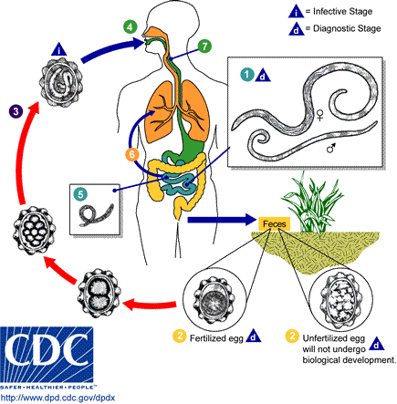

Slide 24
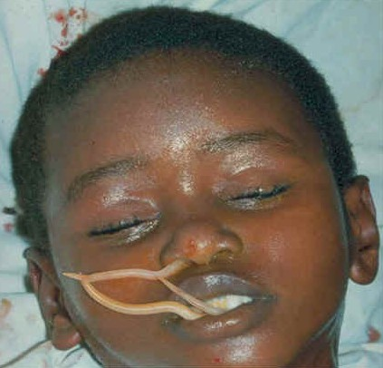
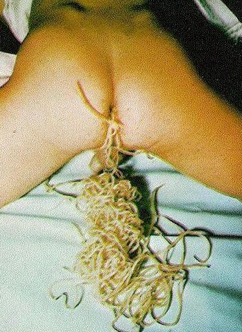
When Ascaris becomes a big problem. . .
Ascaris worms enter the stomach to be vomited and may come out of external nares
Ascaris worms coming out of the anus

Slide 25
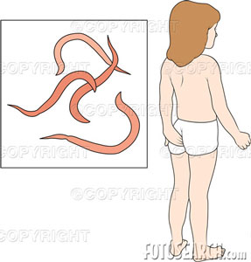
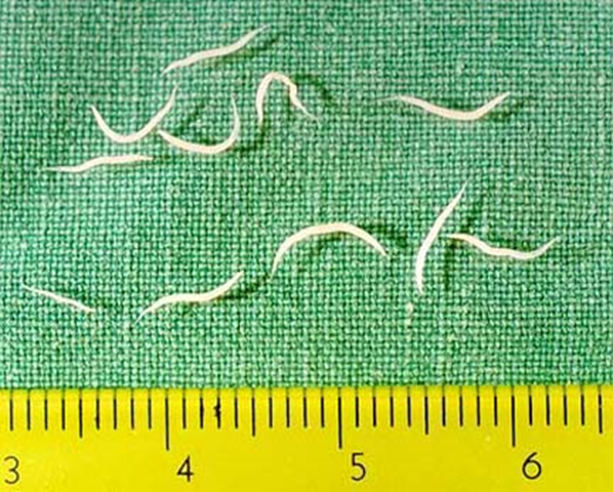
Enterobius vermicularis
Pinworm
Most common parasite in US
Adults live in large intestine
At night females migrate out of the anus and lay eggs on skin.
Human ingest eggs, hatch and molt 4 times in small intestine & migrate to large

Slide 26
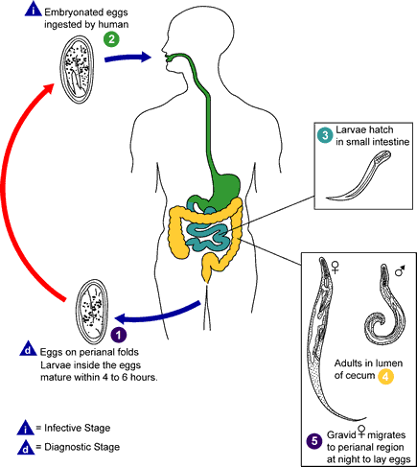

Slide 27
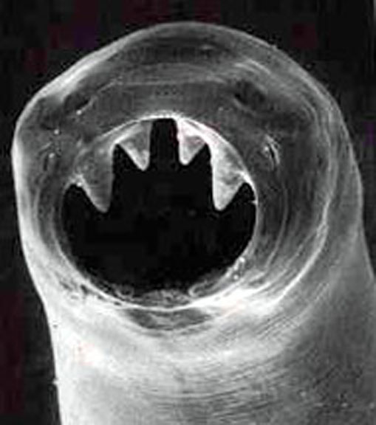
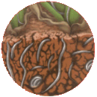
Ancylostoma duodenale
Adults live in small intestine with teeth and feed on blood & tissue fluid
Females 10,000 eggs daily & pass out of body in feces.
Eggs hatch in warm moist soil and releases a small larva, the larva molts and becomes the infective filariform larva.
Notes:
Hookworm

Slide 28
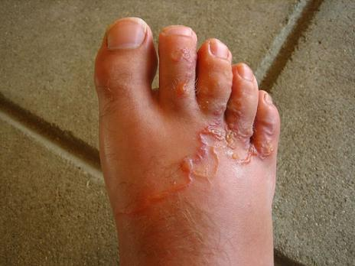
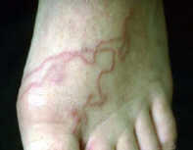
Humans become infected when filariform penetrates the skin (usually b/w toes) to reach our circulatory system
Notes:
Outside defecation and walking barefoot maintains life cycle

Slide 29
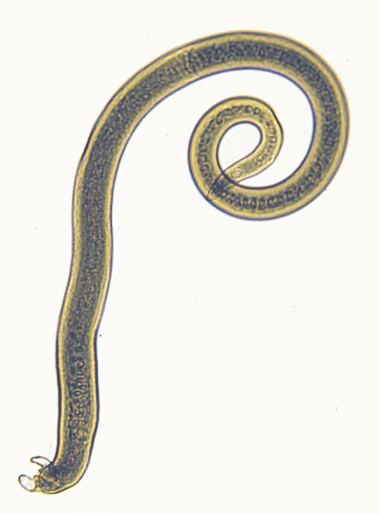
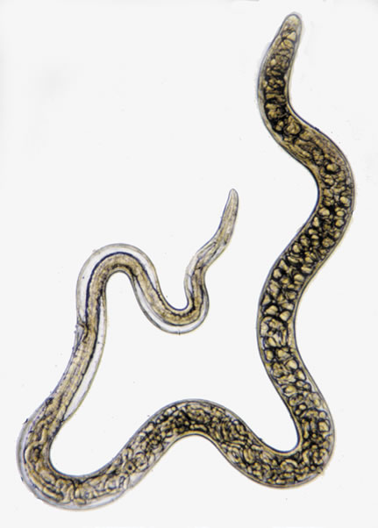

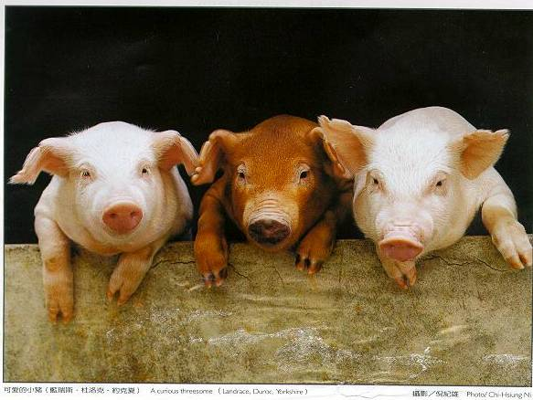



Trichinella spiralis
The Pork worm
Adults live in mucus of small intestine of humans and other mammals Females birth young, larvae enter circulatory system and are carried to Skeletal (striated) Muscles
Adult male
Adult female

Slide 30
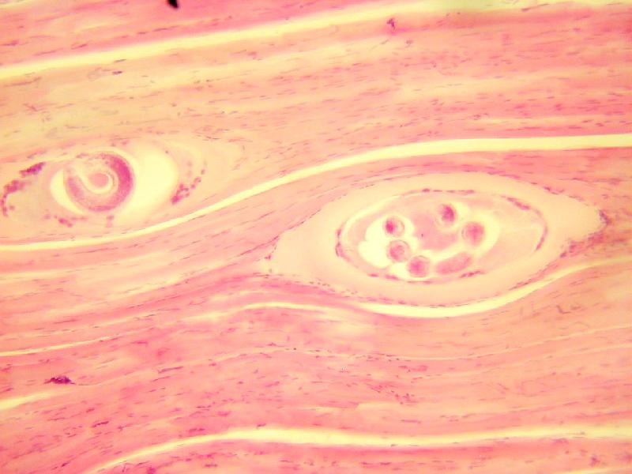
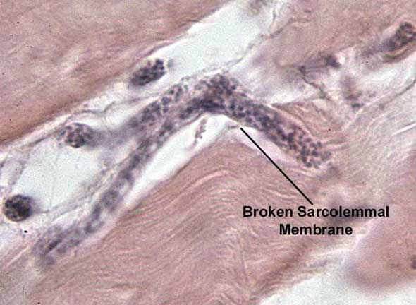
Larvae encyst in muscles & remains infective for many years

Slide 31
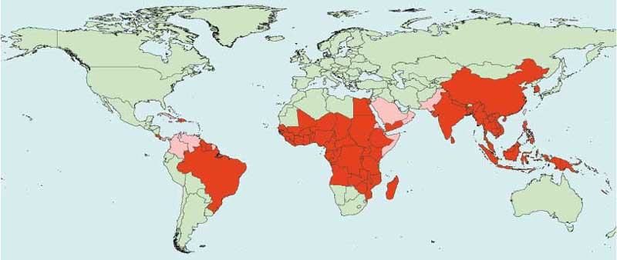
Wuchereria bancrofti
The Filarial worms
In tropical countries over 250 million human infected
Notes:
Lymphatic vessels return tissue fluids to circulatory system

Slide 32
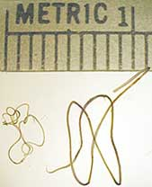
Wuchereria bancrofti
Thread-like worms that live in the Lymphatic System, block the vessels
This causes enlargement of various appendages: Elephantiasis
An Adult female Wuchereria bancrofti is about 80-100 mm long and 0.24-0.30 mm in diameter, whereas a male is about 40 mm long and 0.1 mm in diameter.

Slide 33
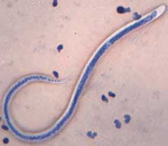
Wuchereria bancrofti
Adults copulate produce microfilariae.
The microfilariae released into the blood stream
A microfilaria is about 240-300 µm (micrometers) long and 7.5-10 µm thick

Slide 34
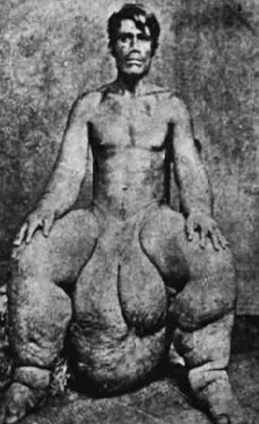
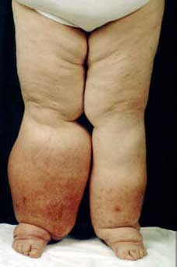

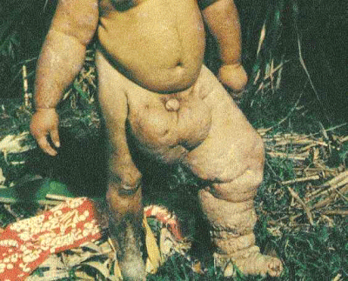
Elephantiasis
Warning: Pictures not for everyone!

Slide 35
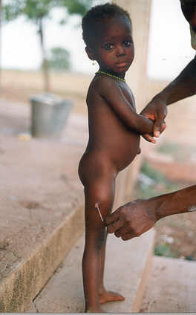
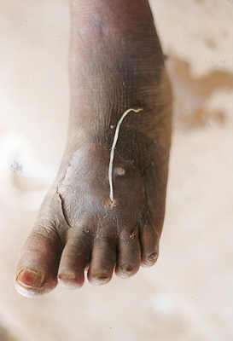
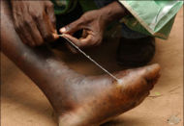
Guinea worms( Dracunculus medinensis )
There is no cure for Guinea worms and the only way to remove one is to slowly over the course of weeks wind the worm out on a stick.
If the worm breaks, a serious bacterial infection results.

Slide 36
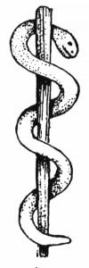


Interestingly, the traditional symbols for medicine
and healing the staff of Asclepias (showing a
snake entwined around a staff) and the caduceus
(which shows two snakes entwined about
a winged staff) very likely are derived from the
Guinea worm removal technique.

